Slide 1
Project Review 1
Team 10
28.11.2023
Notes:
‹#›

Slide 2
Agenda
Sprints
Sprint Goals
Backlog Items, other results
Software demo
Software quality
Spent and remaining effort per person per Sprint
‹#›
Notes:
‹#›

Slide 3
Introduction to the project
What is this project about?
AI-Based Fake Web Shop Detection:
Automatically scraping/crawling websites
Multiple modes:
User driven scraping with UX elements.
Bulk scraping functionality.
Crawling and following links.
AI-based analysis to classify:
Fake webshops
Phishing sites
The project considers detecting fake online shops
‹#›
Notes:
‹#›

Slide 4
Sprint 1
Sprint Goal: Understand existing code and get familiar with needed technology (OK)
Backlog Items chosen to this Sprint
Understand existing code (OK)
Study needed technology (OK)
Define input, output (OK)
Design UI mockup (OK)
Pick library dependencies (for Extraction) (OK)
Pick library dependencies (for Interaction) (OK)
Decide what features to extract (OK)
Other notable achievements
Additional task: Create base for testing.
Created a guide for Installation / Setting up the project
Main findings from the Sprint retro
Sprint Retro + Planning will be held after this Project Review meetings.
‹#›
Notes:
‹#›

Slide 5

Software demo
‹#›
Notes:
‹#›

Slide 6
Code demo
Kaarlo and Joonas

Slide 7
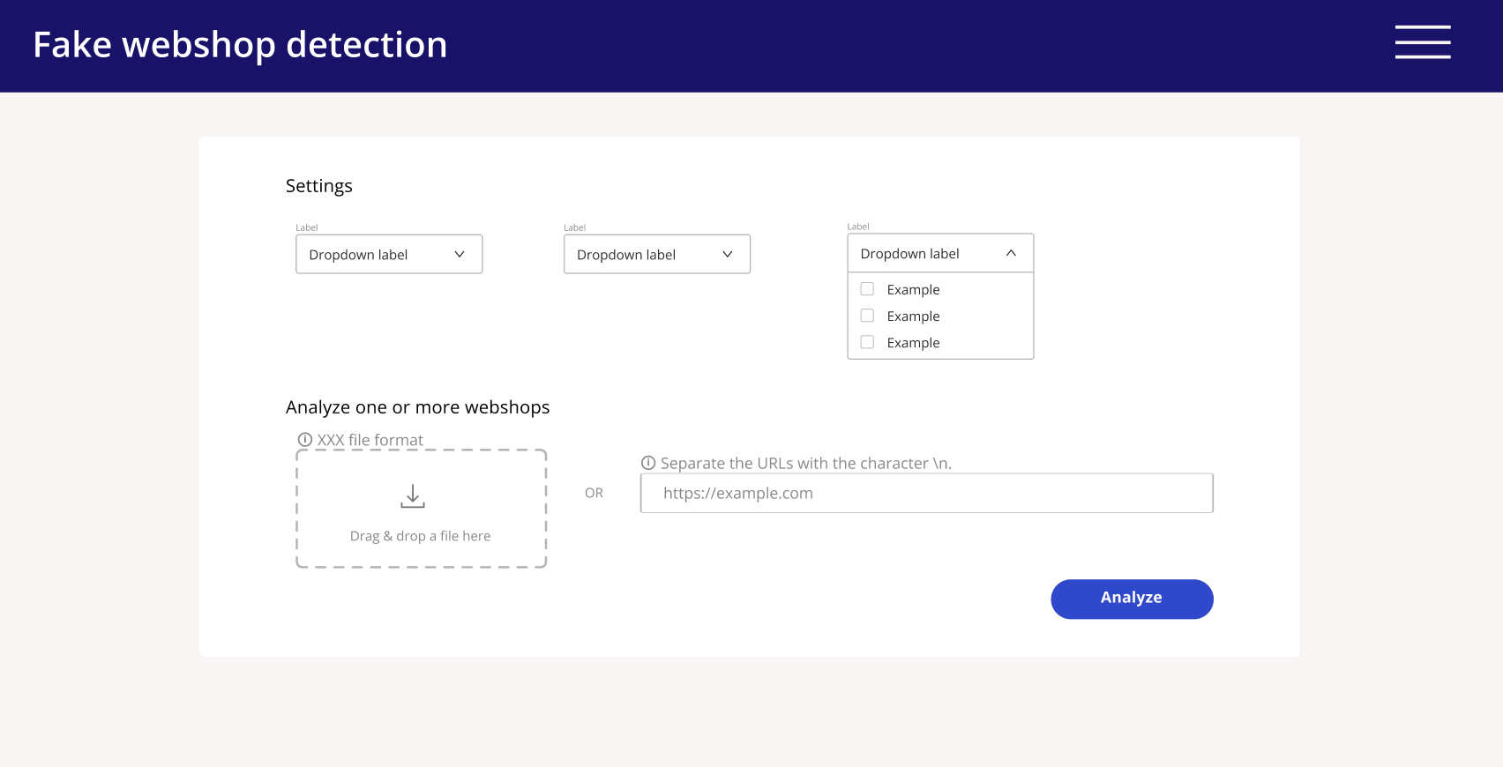
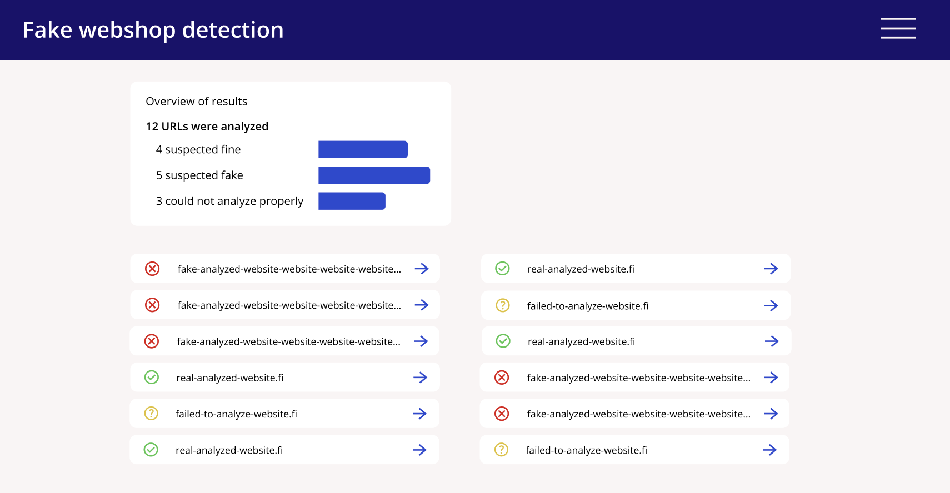
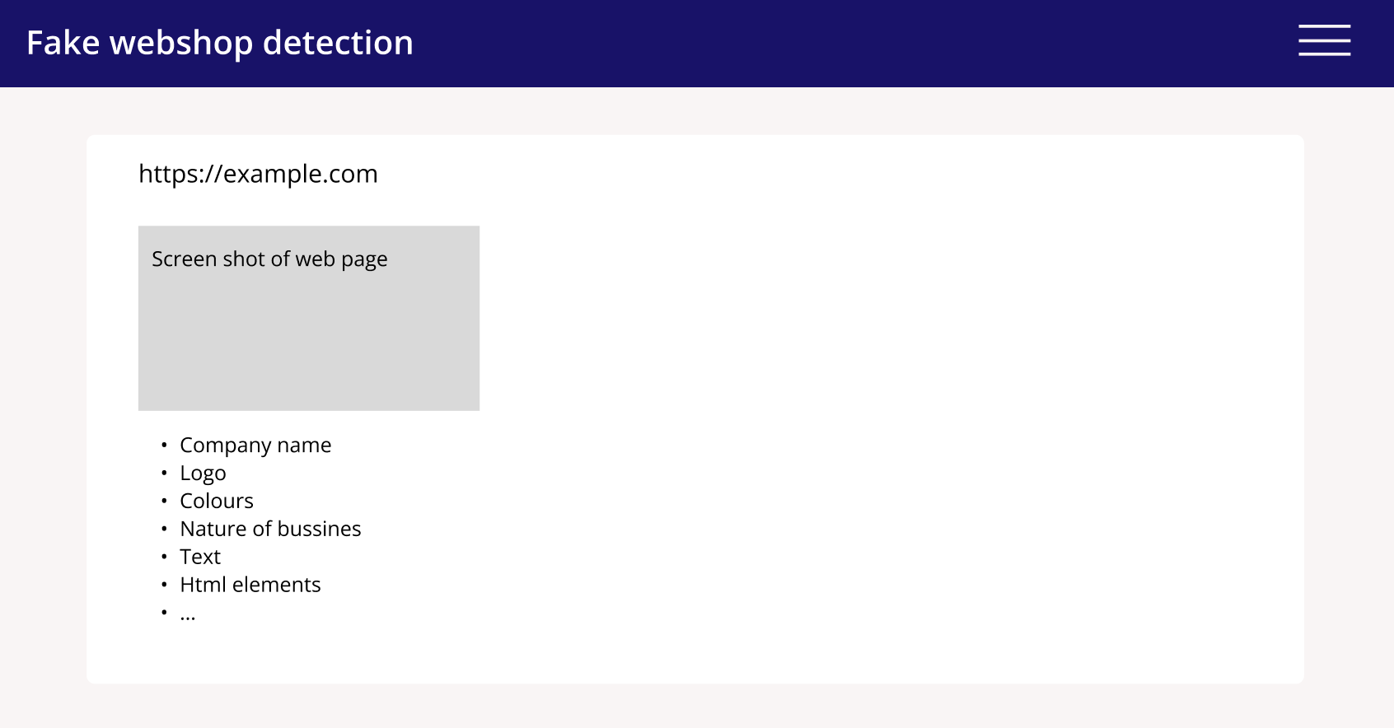
UI mockup demo
, Heidi
Homepage
Overview of results
Single result

Slide 8
Software quality
List of the most important quality attributes
Documentation
Usability
Definition of Done
Main content:
Unit tests pass
Unit tests must cover all the core features
Code is reviewed by at least 2 people
Documentation:
requirements
source code
maintenance guide
interaction
Use case fully work
DoD was not changed since the last Sprint Planning
‹#›
Notes:
‹#›

Slide 9
Hours planned and done
 | Hao (SM) | Nina | Joonas | Erika | Sofia | Kaarlo | Tuomo | Binh | Heidi | SUM
Total planned | 125 | 225 | 225 | 225 | 225 | 225 | 225 | 225 | 225 | 1925
Total done | 48 | 46 |  | 23 | 14 | 33 | 22 | 14 | 27
Sprint 0 (done) | 28 | 18 |  | 9 | 5 | 8 | 9 | 10 | 2
Sprint 1 (done) | 20 | 28 |  | 14 | 9 | 25 | 13 | 4 | 25
Sprint 2
Sprint 3
Sprint 4
Sprint N
‹#›
Notes:
‹#›

